Slide 1
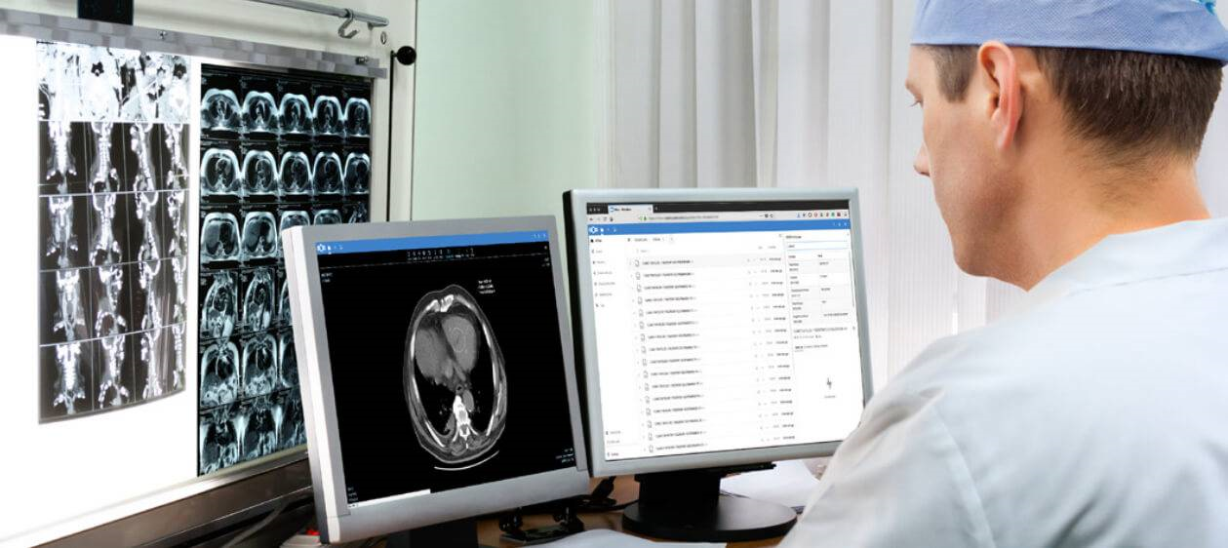

Slide 2

Edge Detection filters
CannyNot important with medical image because canny is sensitive for edge detection
Laplacian
Laplacian of Gaussian
Sobel Operator
Prewitt
Kirsch
Emboss

Slide 3
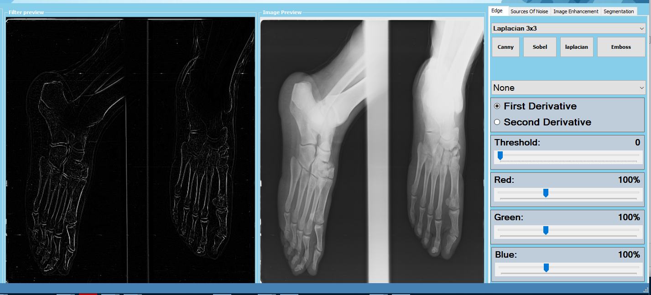
Laplacian filter 3x3

Slide 4

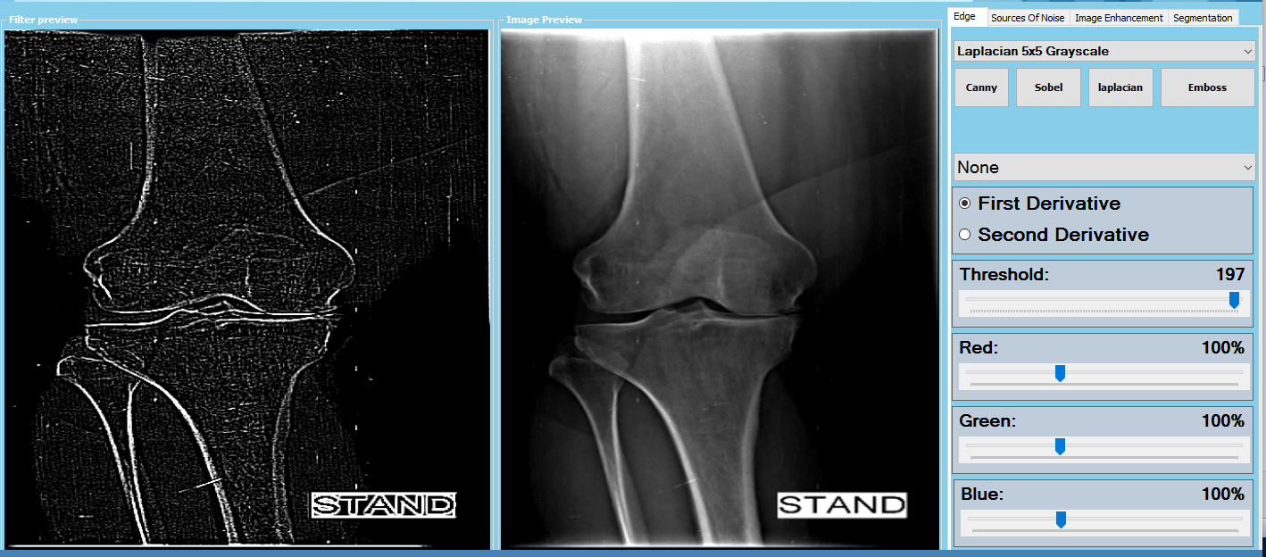
Laplacian filter 5x5
Very Good to show edges in xray to show the Degenerative joint Diseases clearly
This is the normal because we must find distance between the bones to deny the friction of cartilage

Slide 5
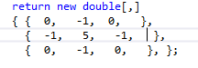
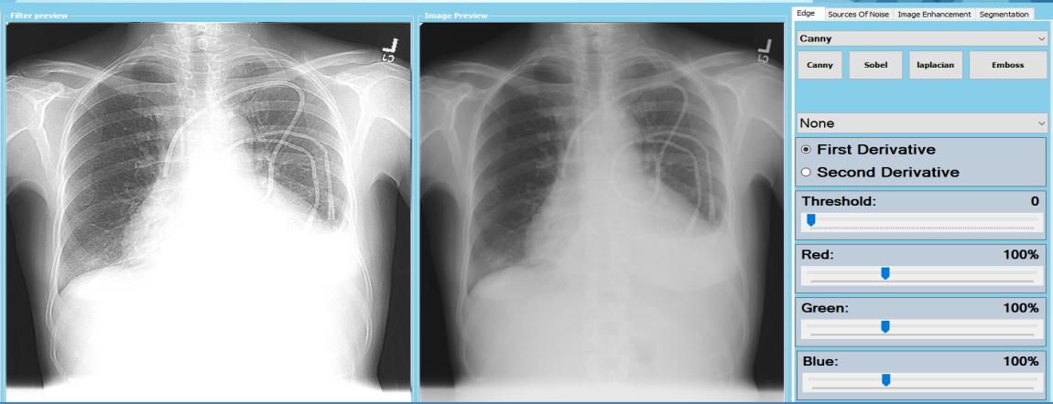
18-apply this edge filter into medical X-ray chest image

Slide 6

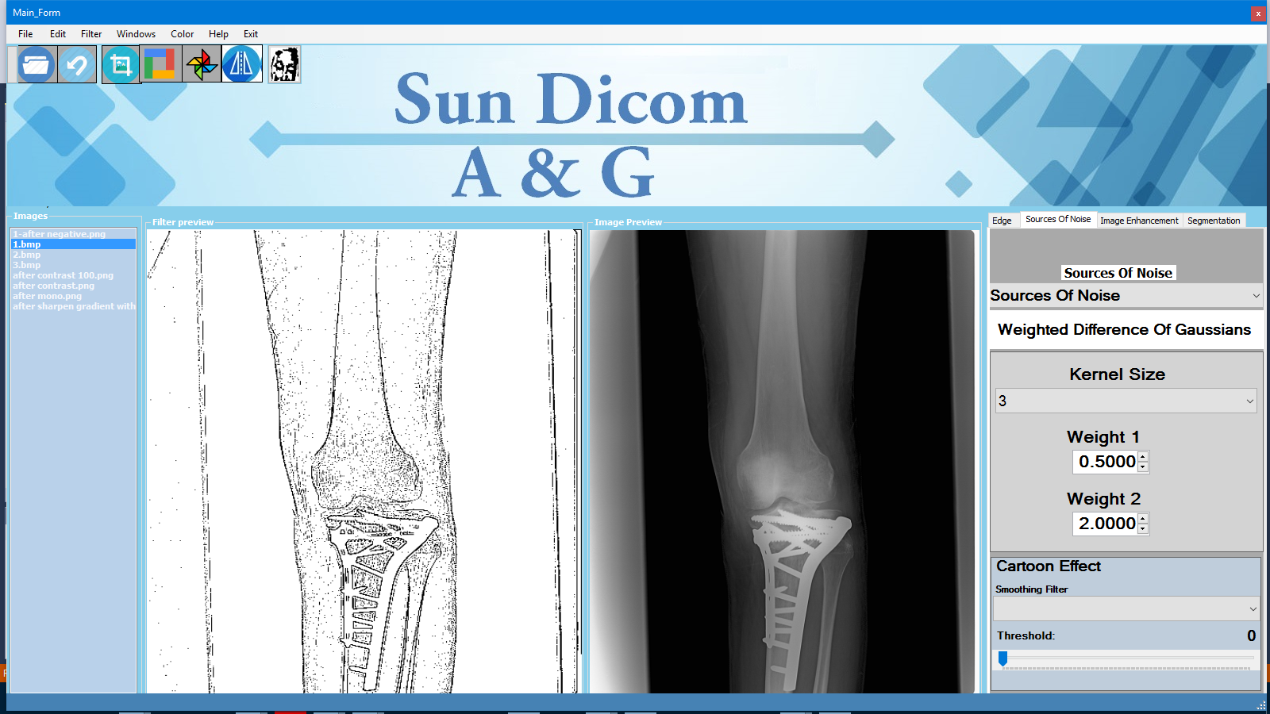
Apply basic Neural network (fully connected layer )weight Difference of Gaussian with filter 3x3 and weight 0.5 and 2 And we can change the weight to adjust the edges

Slide 7
Sources Of Noise

Slide 8
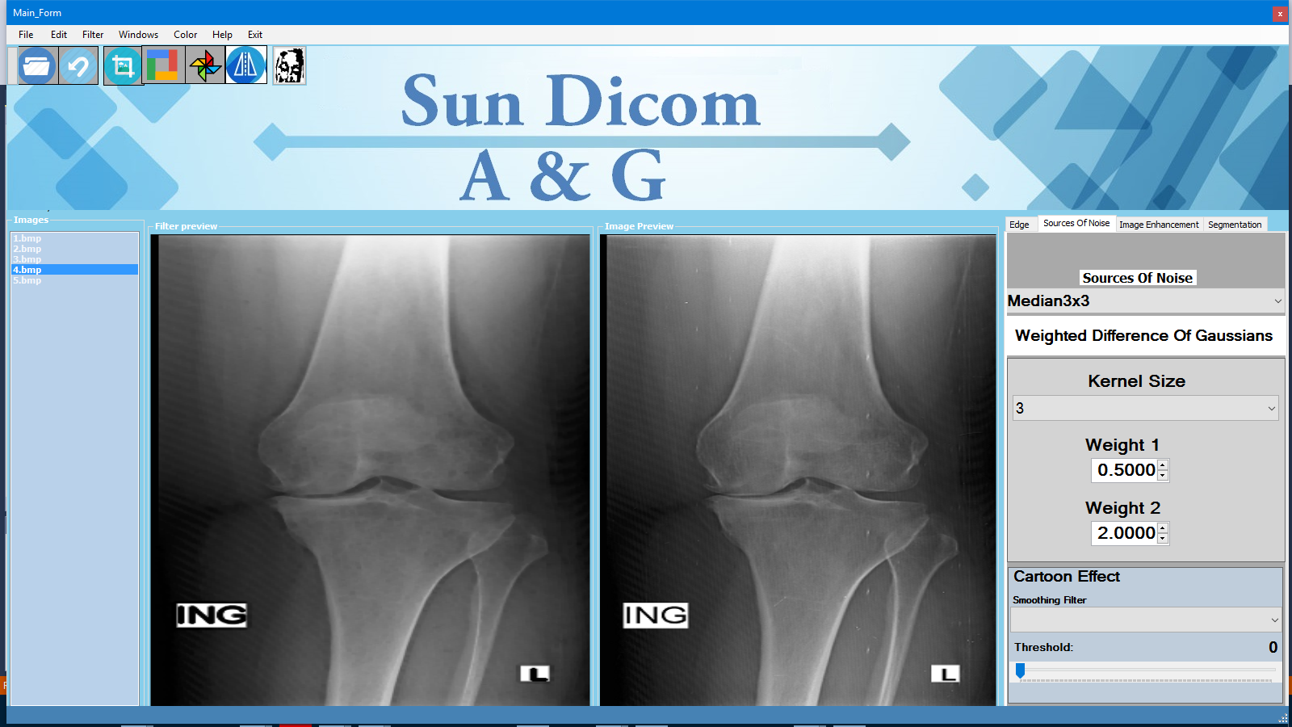
Apply Median Filter 5x5 with Salt noise

Slide 9
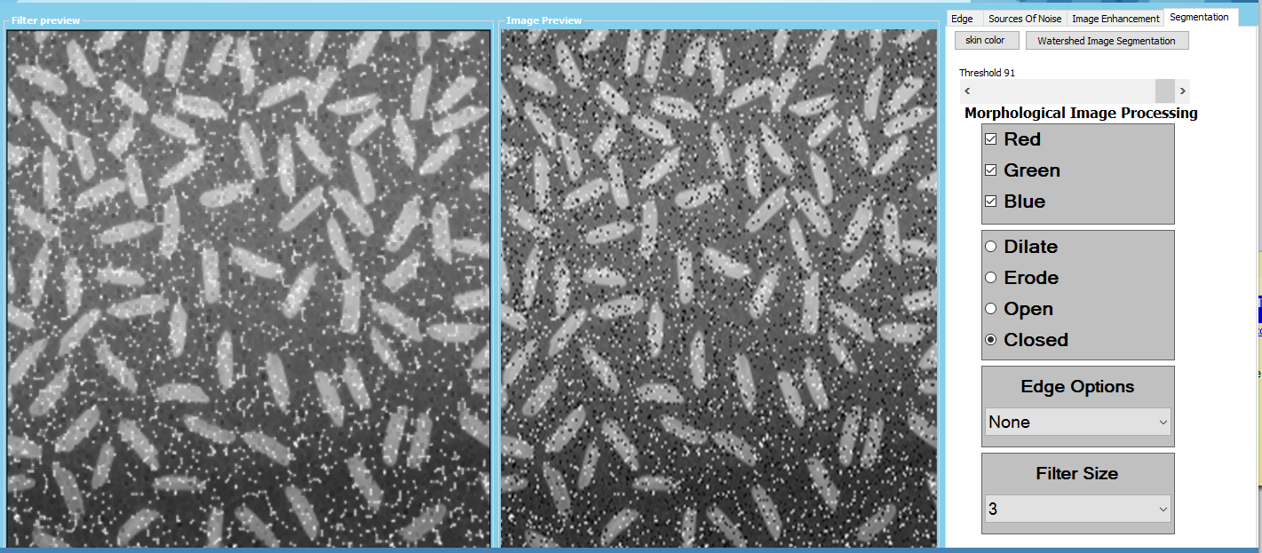
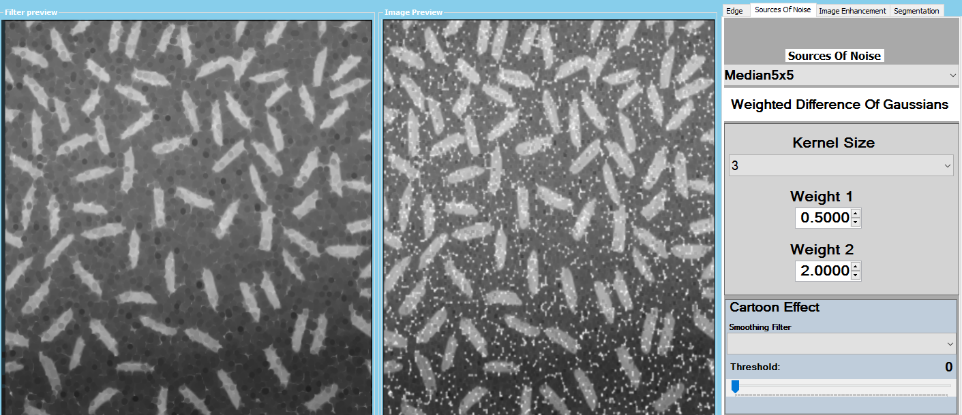
remove pepper and salt noise by closed filter the median 5x5

Slide 10
Image Enhancement

Slide 11
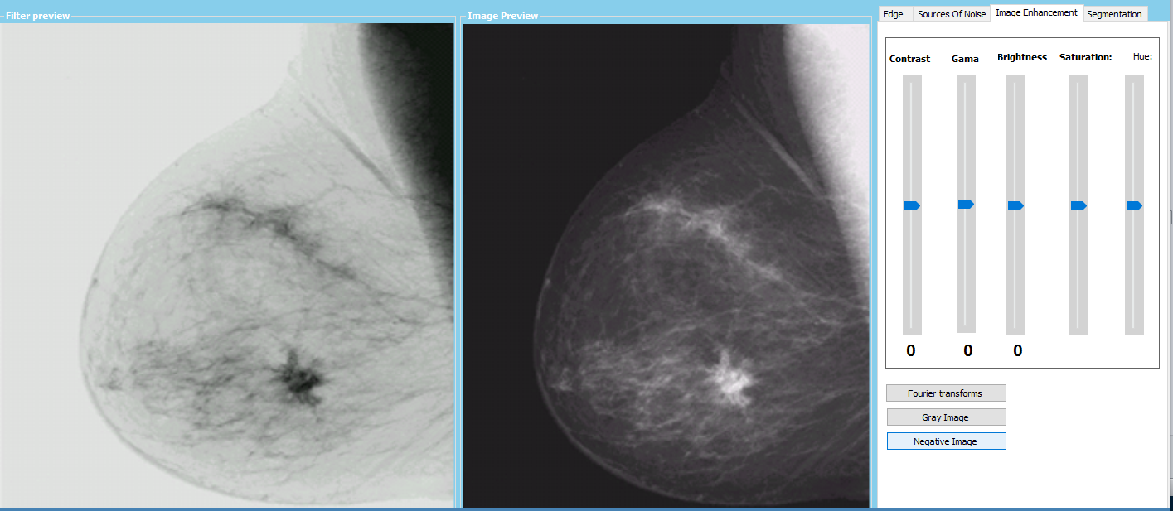
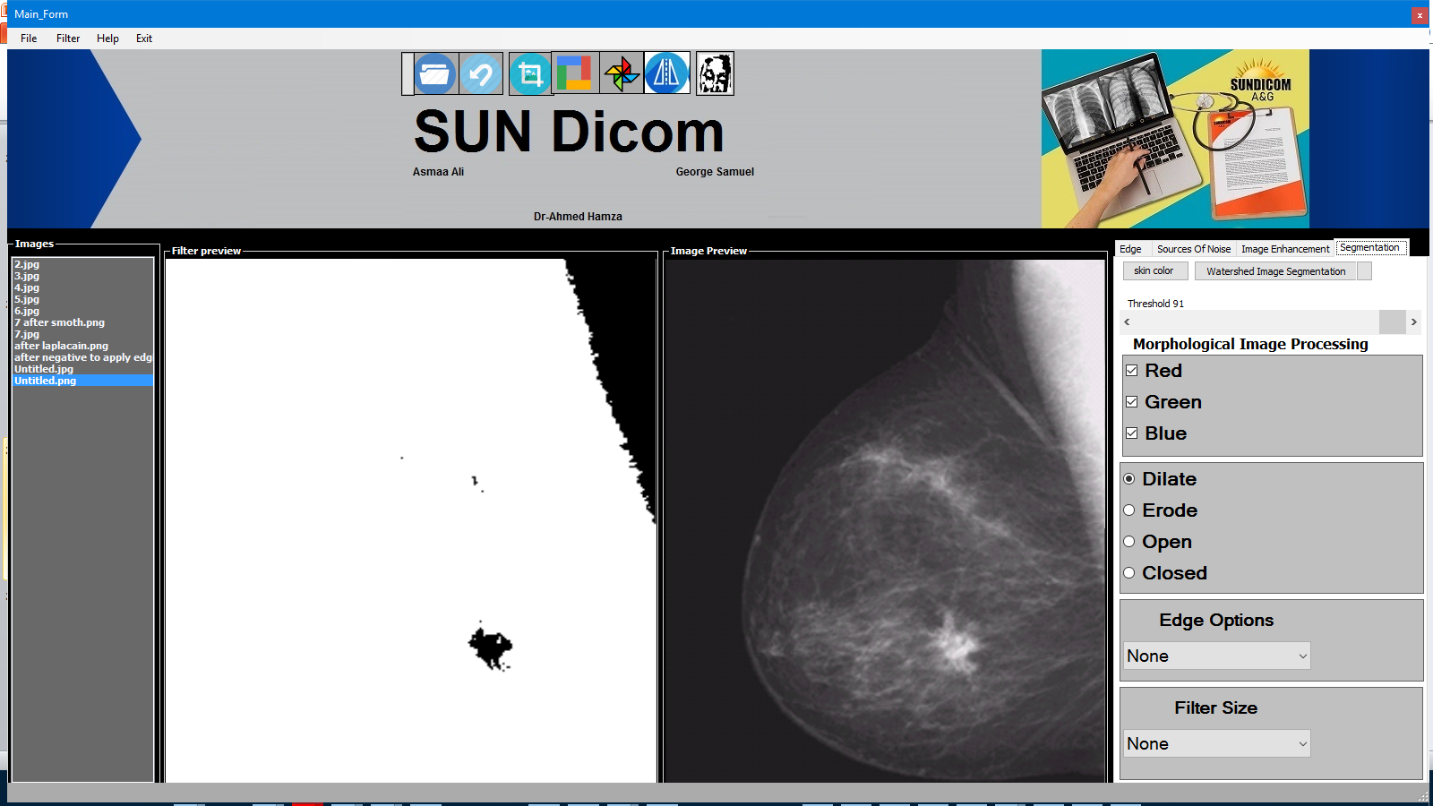

Slide 12
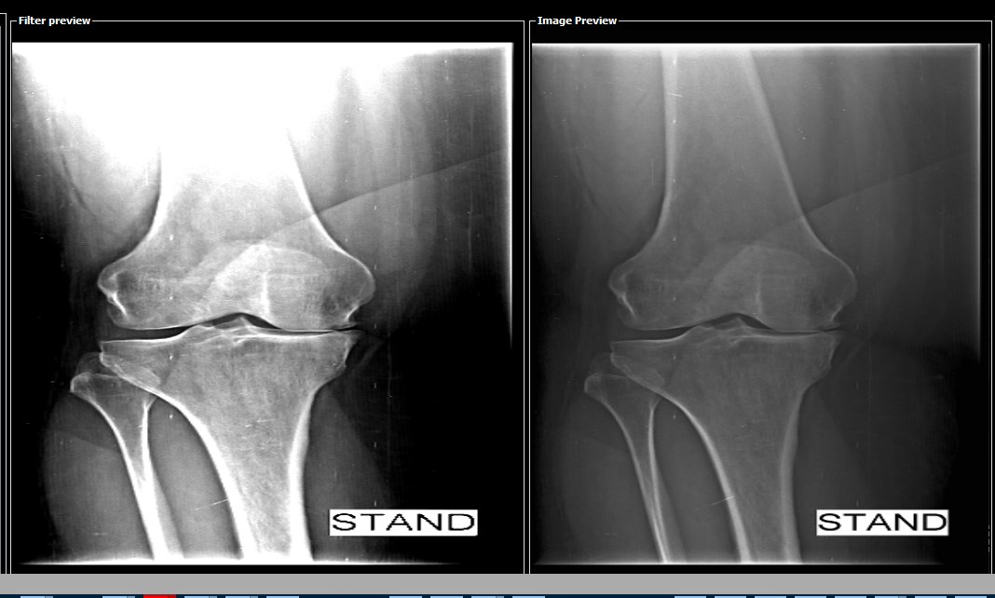
Adjust Contrast and Brightness To make Enhancement on knee

Slide 13
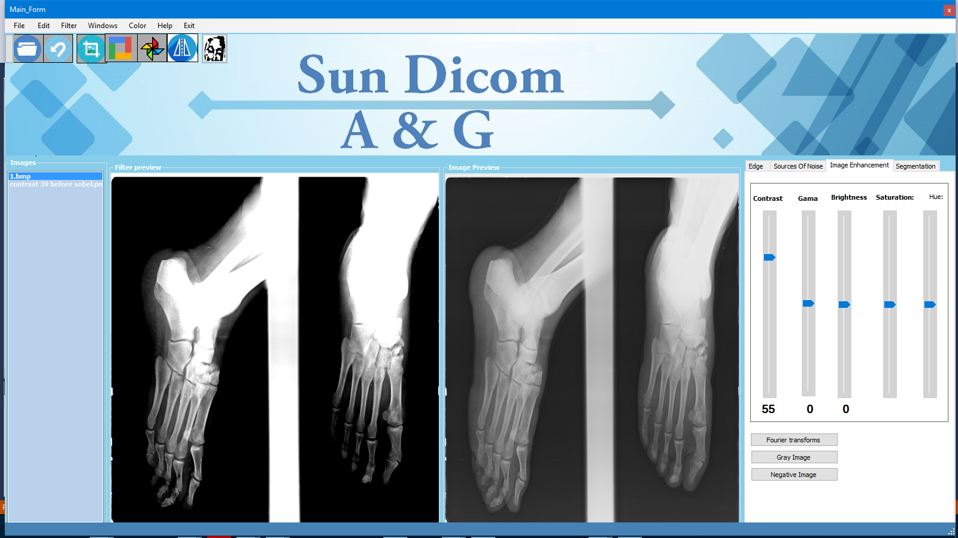
Adjust Contrast and Brightness To make Enhancement on foot

Slide 14
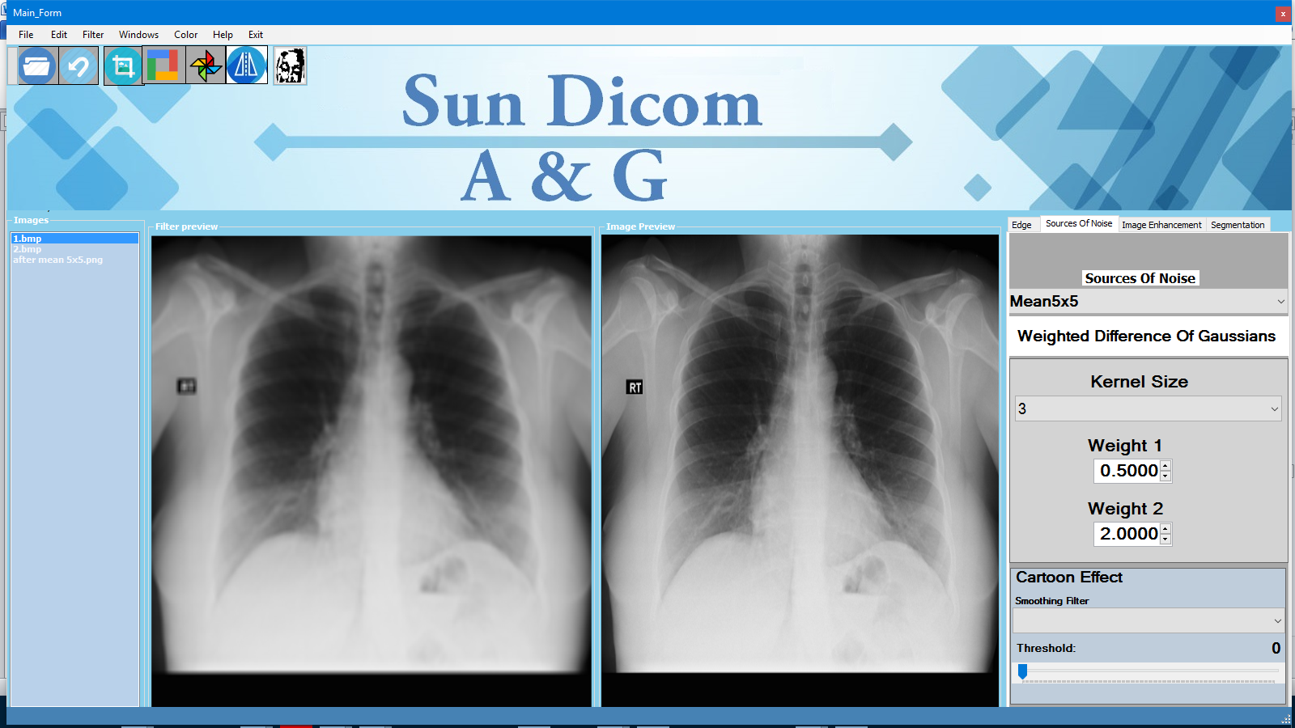
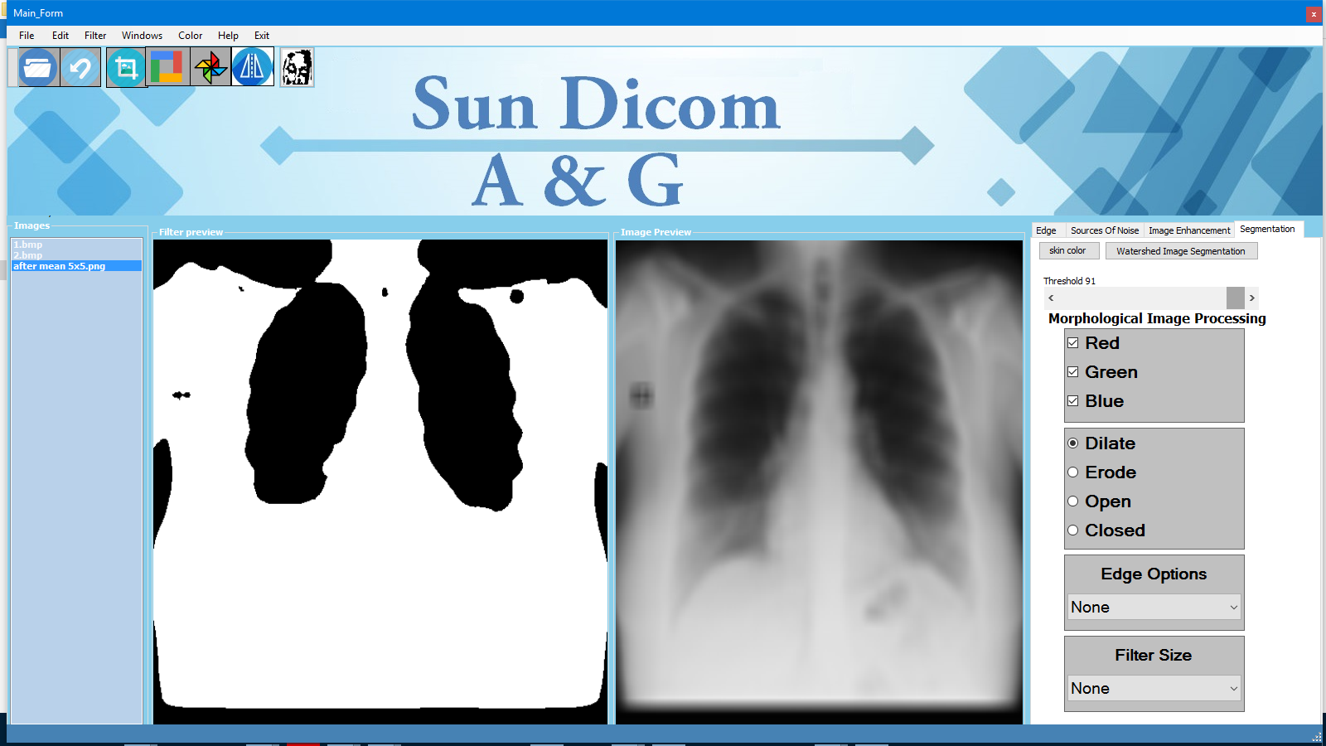

Slide 15
Fourier Transform

Slide 16
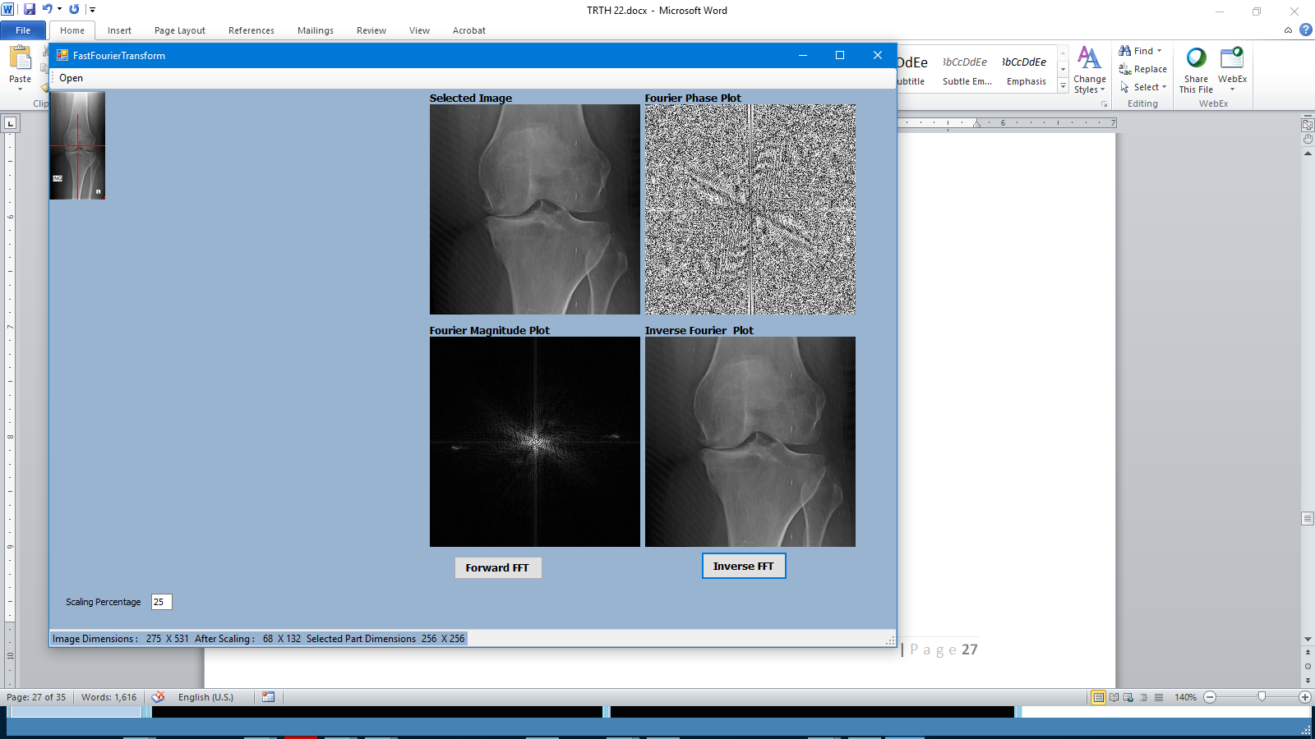
2D Discrete Fourier Transform (2D-DFT)

Slide 17
Segmentation

Slide 18
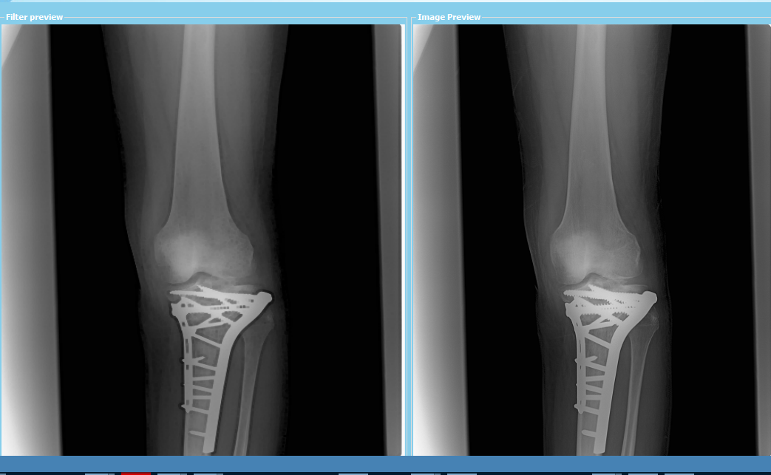
Erosion 3x3

Slide 19
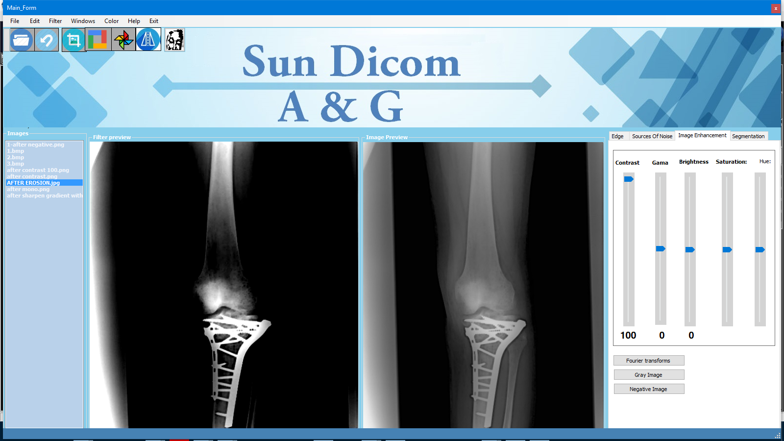
Apply contrast After Erosion

Slide 20
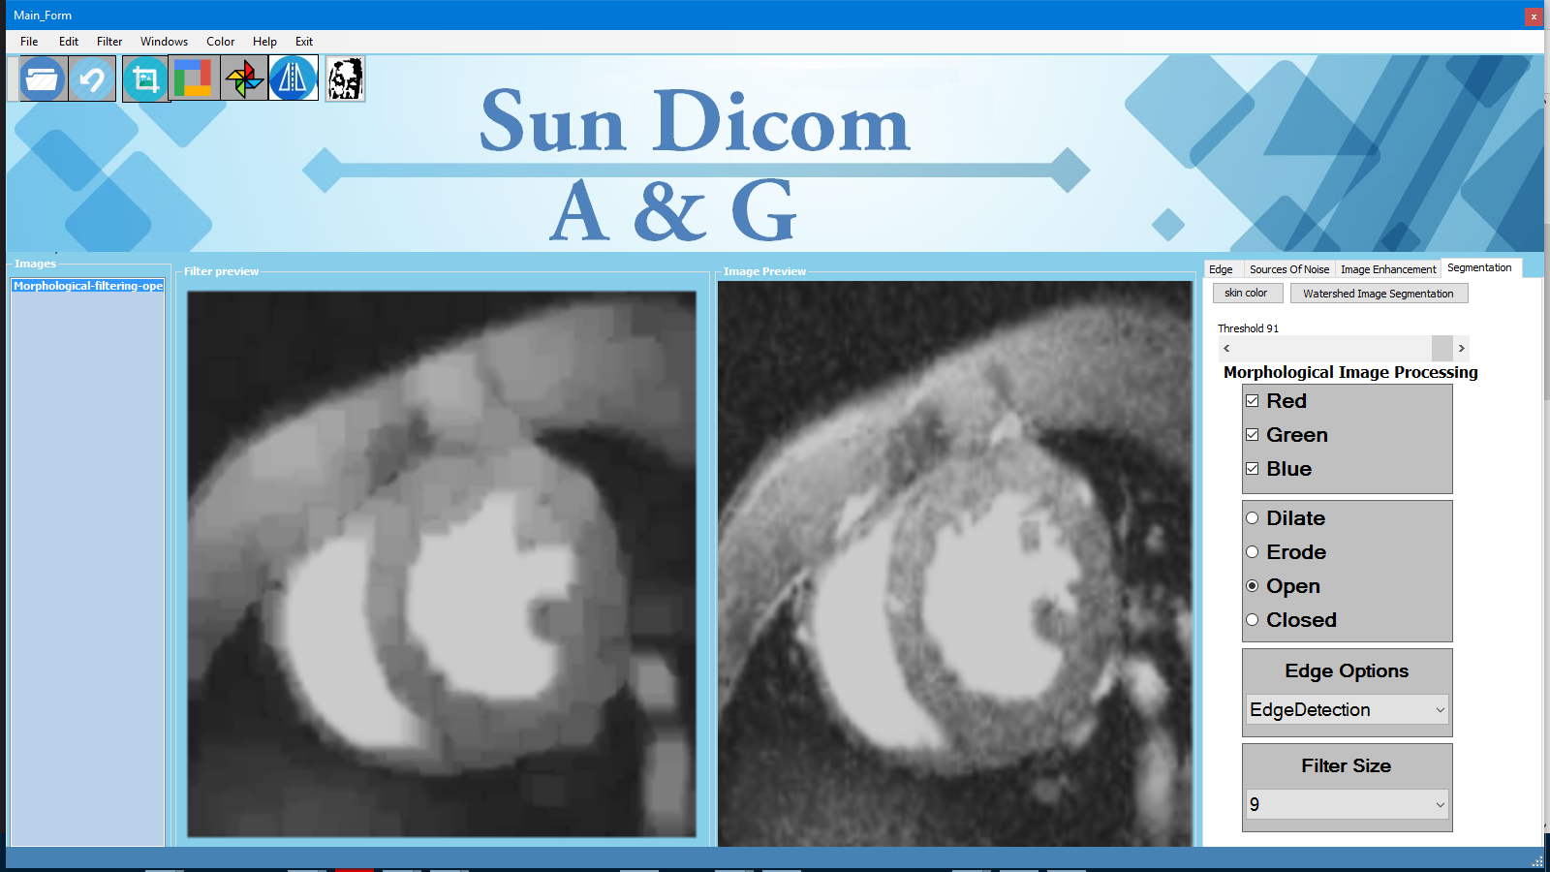
Opening 9x9 for heart MRI

Slide 21
More way to diagnoses the cancer
First Way
For the original CT Brain has a Cancer
Apply Open filter with window size 5x5
Apply erosion 9x9
Then apply open filter 17x17
Apply mean Gaussian filter to make a good smooth
Apply threshold to appear the Cancer

Slide 22
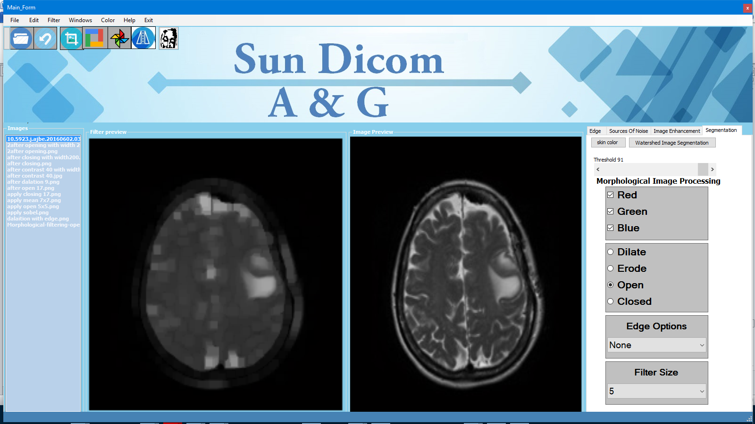
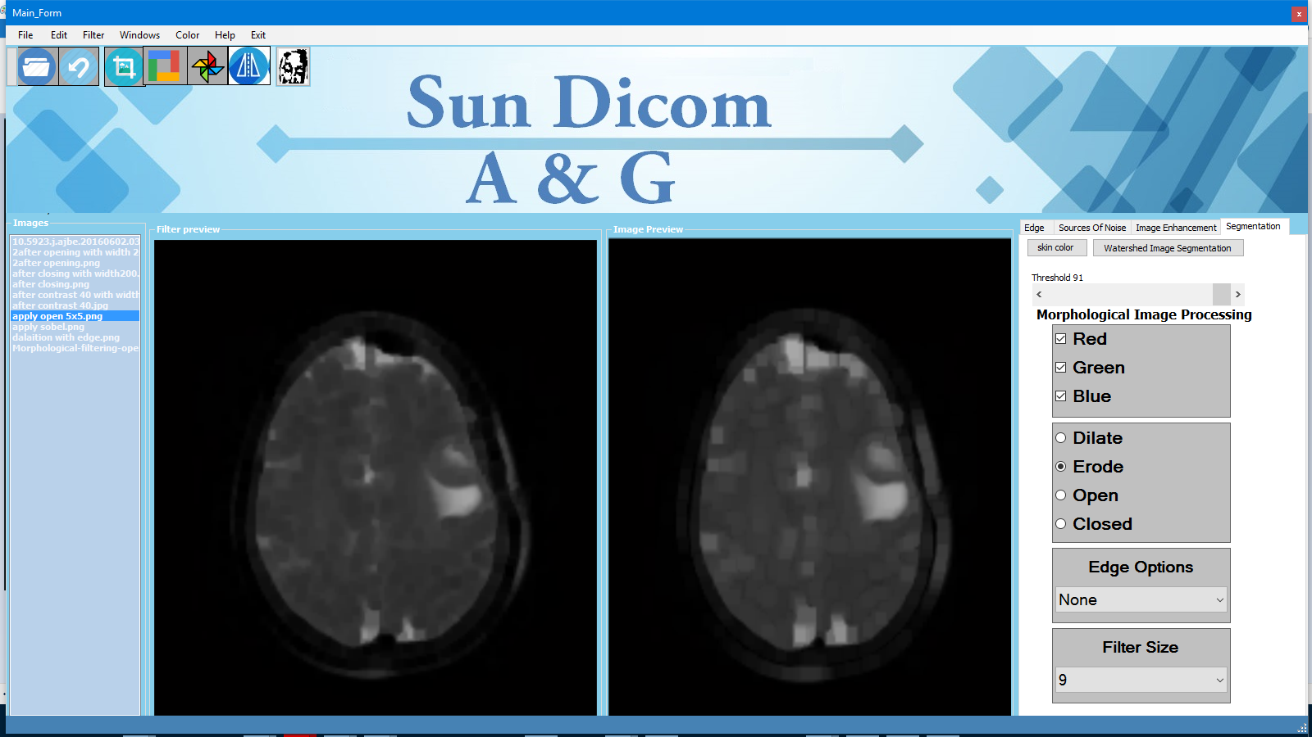

Slide 23
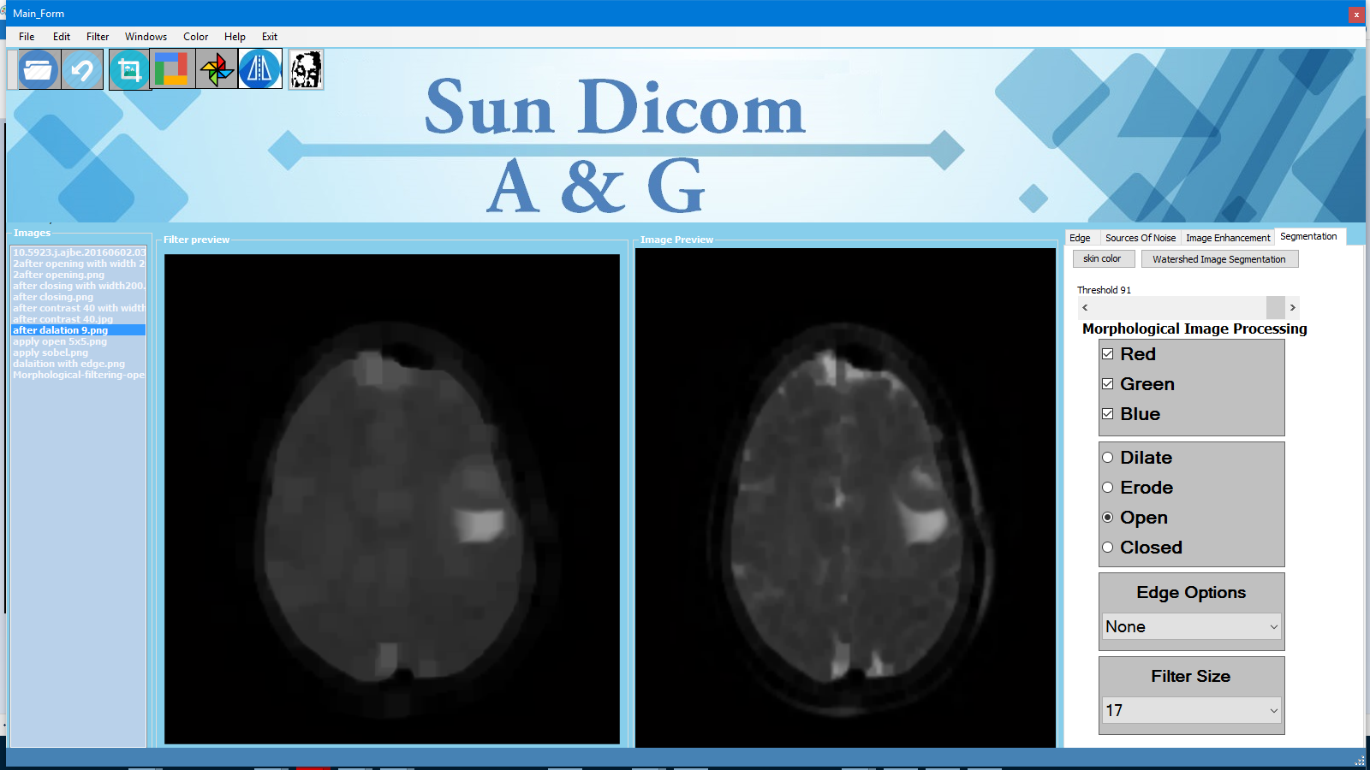
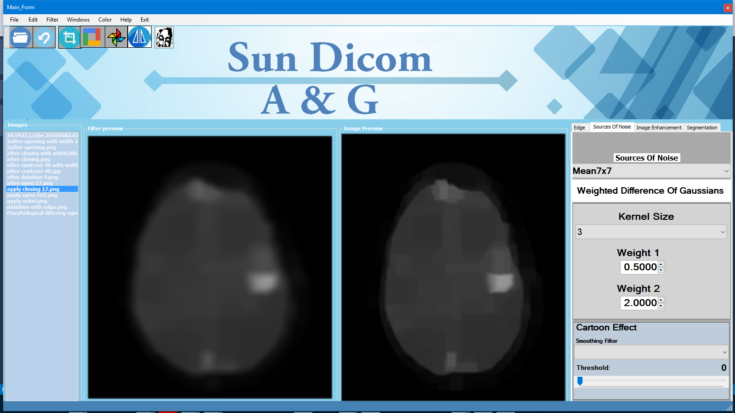

Slide 24
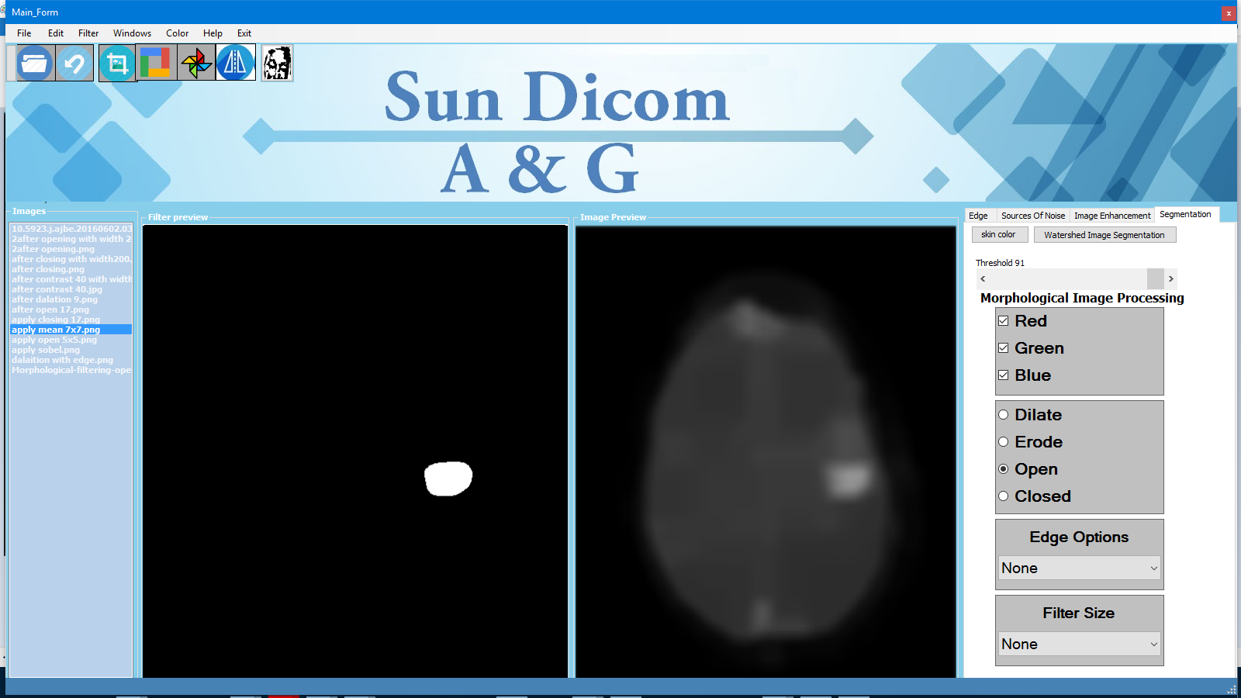
The Final Result

Slide 25
The second way
Apply opening Filter 11x11
Then apply closing filter 17x17
Then apply threshold filter

Slide 26
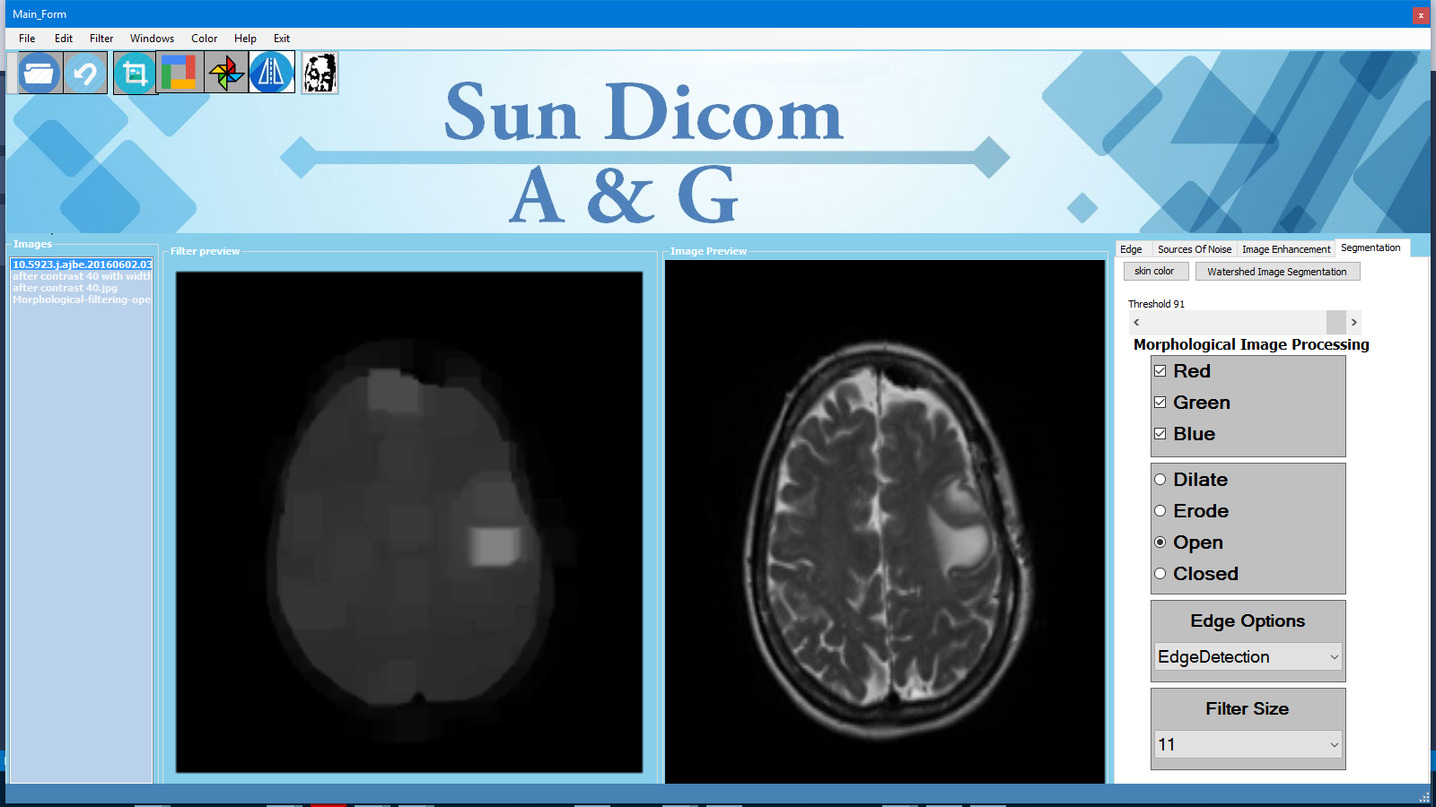
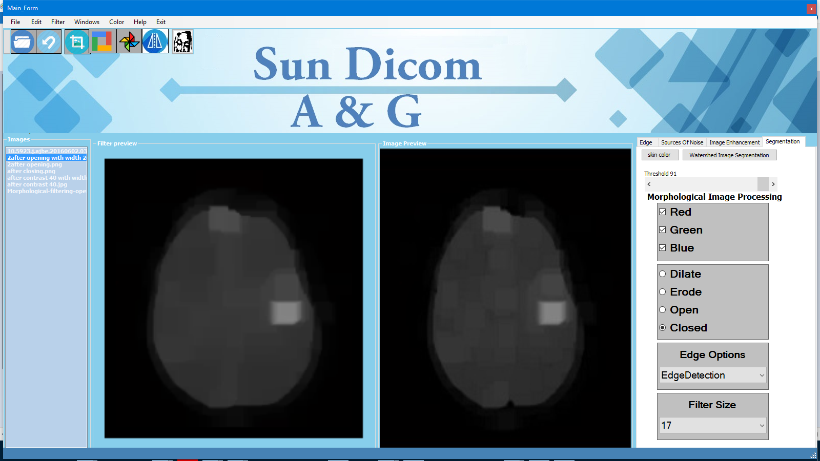

Slide 27

The Final Result

Slide 28
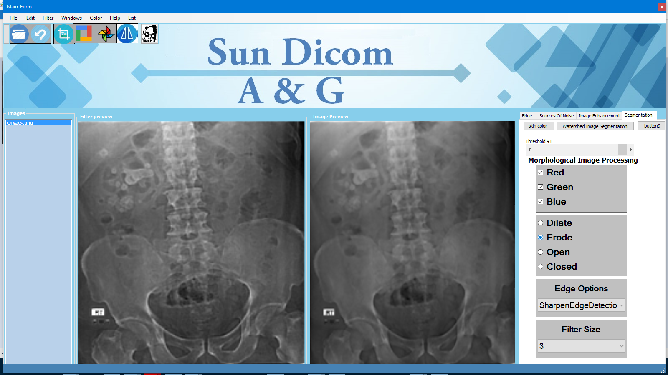
erosion With sharpen edge detection with window size filter 3x3
Kidney Stone

Slide 29
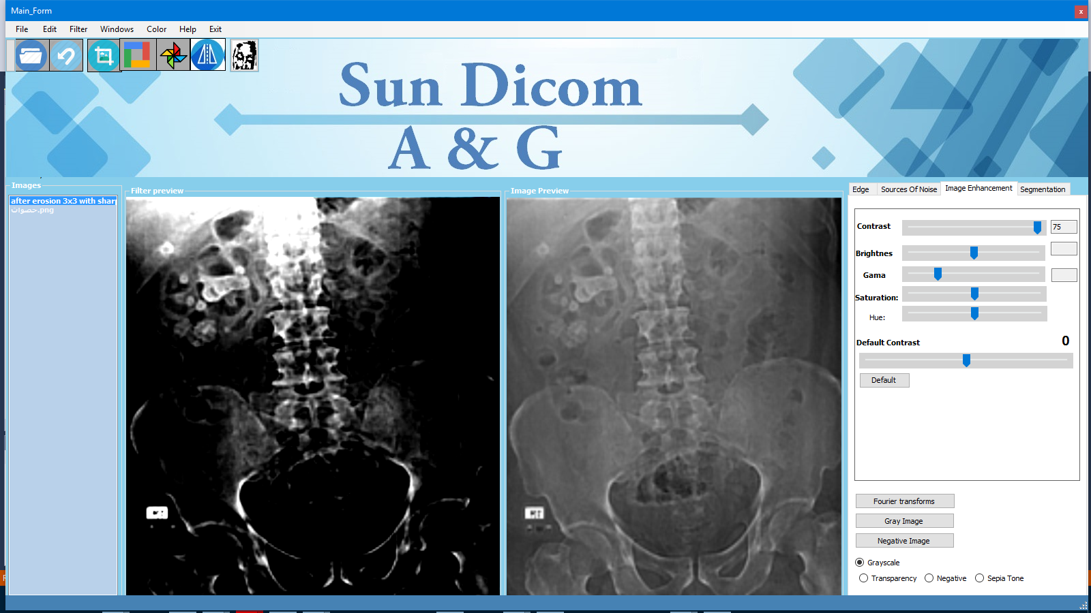
Raise the contrast to 75

Slide 30
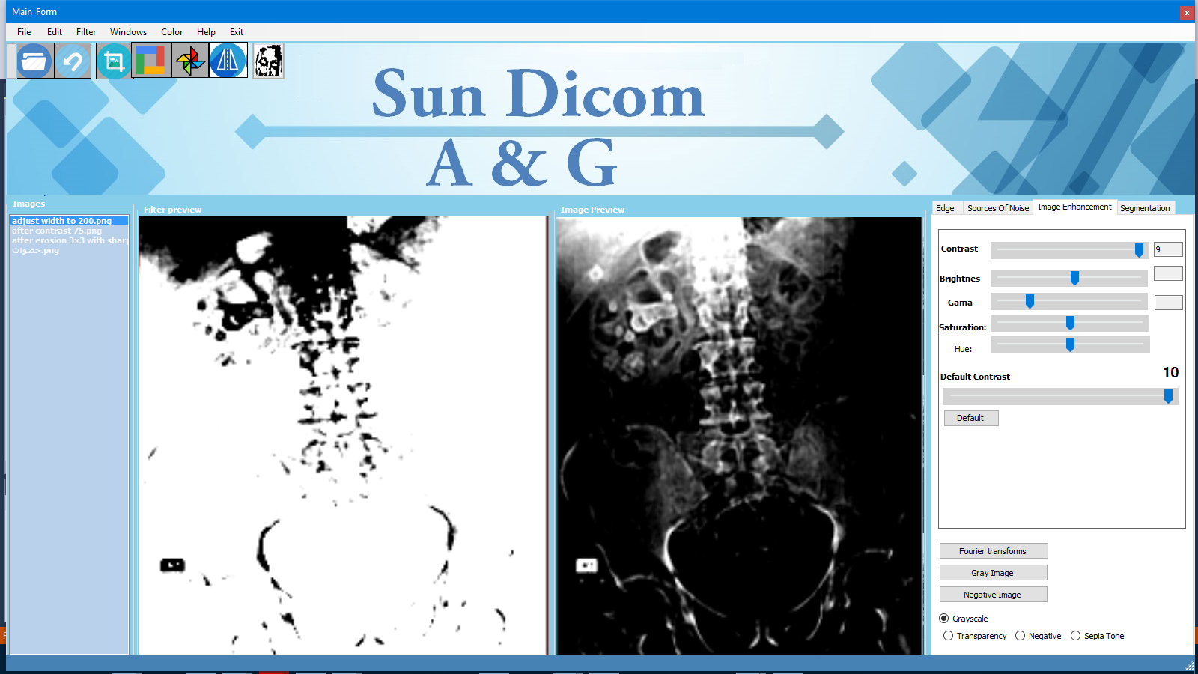
Apply threshold or raise contrast to 9

Slide 31
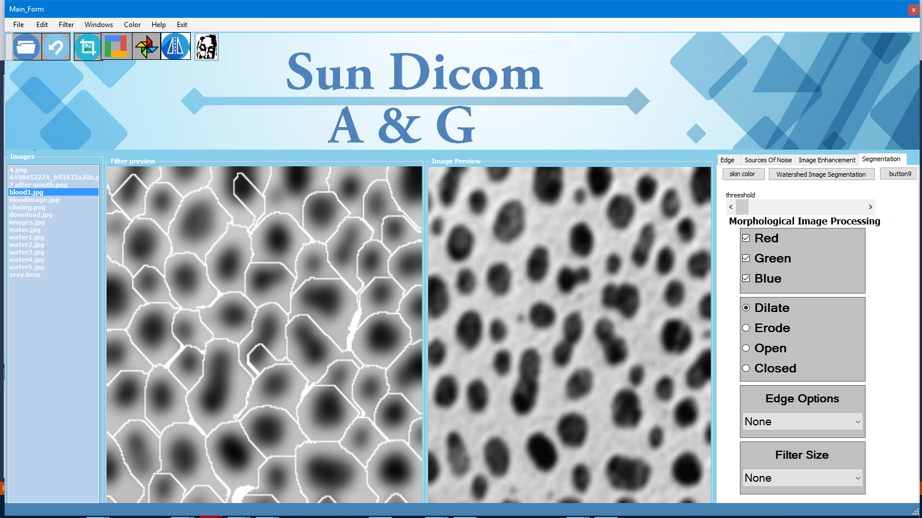
Watershed filter to segment the the blood cell and x-ray chest lung Cancer

Slide 32
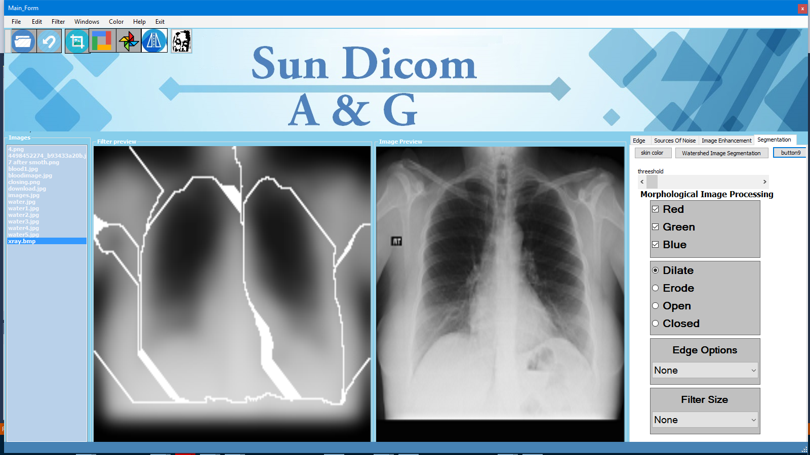
apply watershed for lunge Cancer

Slide 33
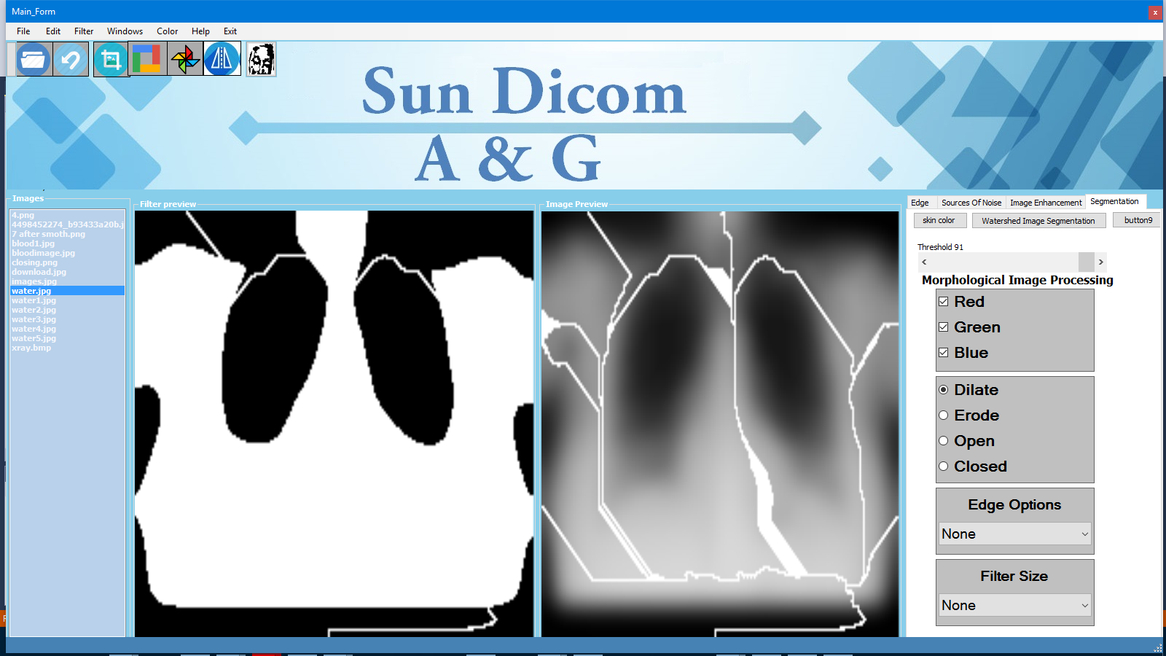
Apply threshold 91

Slide 34
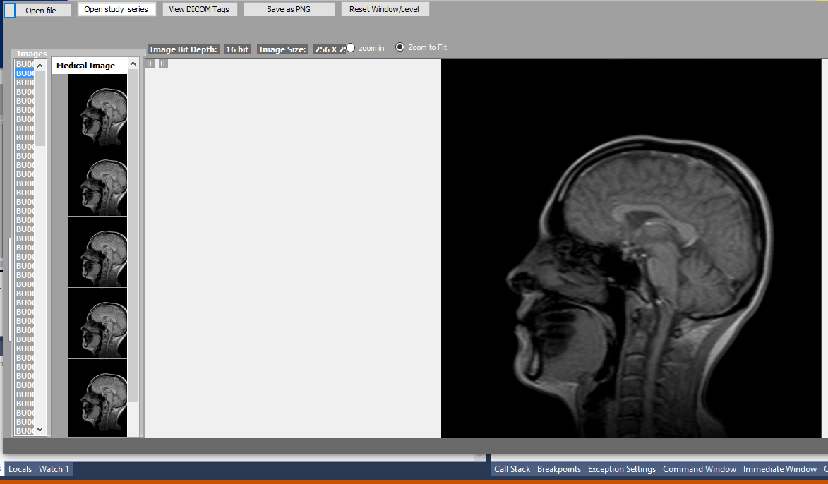
Dicom viewer with Window Level control
(Contrast –brightness- Gama - threshold)

Slide 35
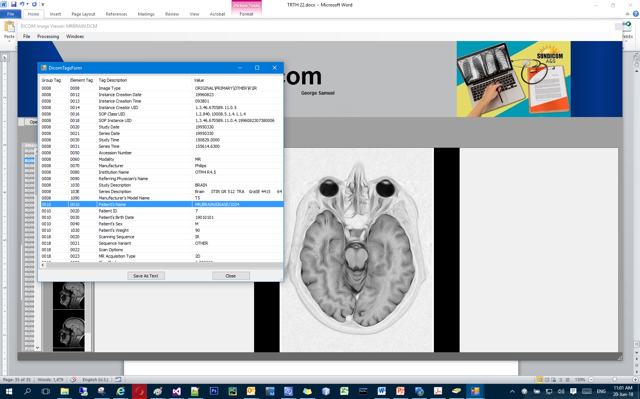
View Tags Form to Show Information About The Dicom Image Like Patient ID And Patient Name and the Date of starting the check ….etc.

Slide 36
Thank You
SunDicom Team

